Slide 1

FPT University
Android programMing
Lesson 3
Version 1.0

Slide 2
Agenda
Understanding Android Views, View Groups and Layouts
A Guide to the Android Studio Layout Editor Tool
A Guide to the Android ConstraintLayout
An Android Studio Layout Editor ConstraintLayout Tutorial

Slide 3
Understanding Android Views, View Groups and Layouts
Designing for Different Android Devices
Views and View Groups
Every item in a user interface is a subclass of the android.view.View
A view can also be comprised of multiple other views Such views are subclassed from the Android ViewGroup class (android.view.ViewGroup)
Notes:
SGL = Scalable Graphics Library
SSL = Secured socket layout

Slide 4
Understanding Android Views, View Groups and Layouts
Android Layout Managers
ConstraintLayout
LinearLayout
TableLayout
FrameLayout
RelativeLayout
AbsoluteLayout
GridLayout
CoordinatorLayout

Slide 5
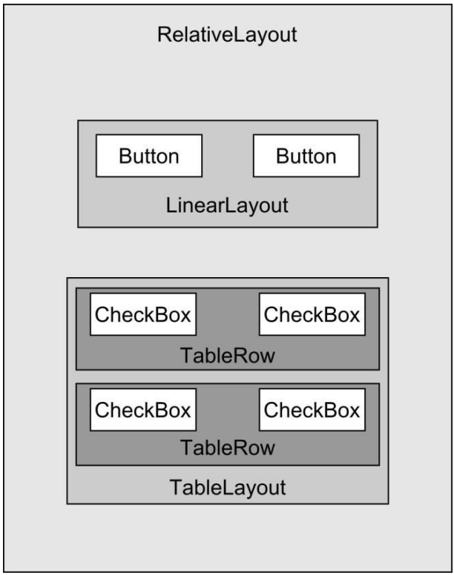
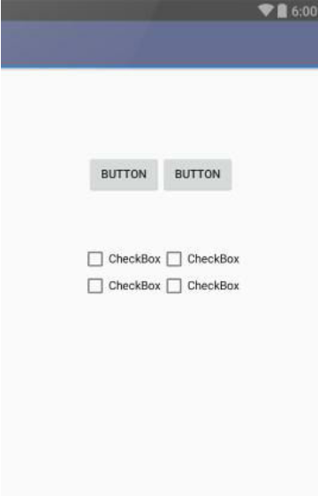
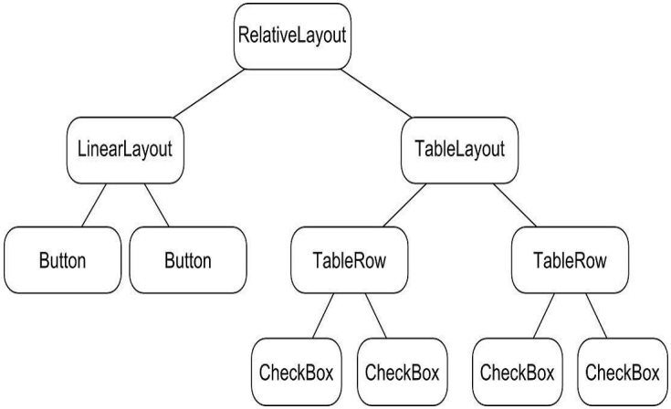
Understanding Android Views, View Groups and Layouts
The View Hierarchy

Slide 6
A Guide to the Android Studio Layout Editor Tool
The Android Studio Layout Editor
Design Mode
Text Mode
Setting Properties

Slide 7
A Guide to the Android ConstraintLayout
How ConstraintLayout Works · Constraints · Margins · Opposing Constraints · Constraint Bias · Chains · Chain Styles

Slide 8
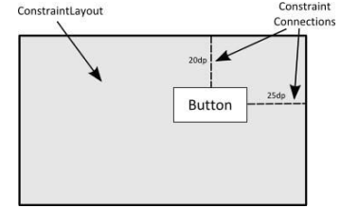
A Guide to the Android ConstraintLayout
Constraints
Constraints are essentially sets of rules that dictate the way in which a widget is aligned and distanced in relation to other widgets
Margins
A margin is a form of constraint that specifies a fixed distance
<TextView android:id="@+id/textView2" android:layout_width="wrap_content" android:layout_height="wrap_content" android:layout_marginStart="8dp" android:layout_marginTop="8dp" android:layout_marginEnd="8dp" android:layout_marginBottom="8dp" android:text="Activity 2" android:textColor="@color/colorAccent" android:textSize="30sp" />

Slide 9
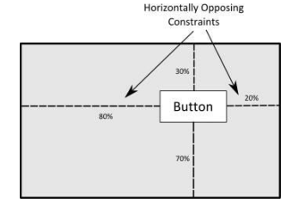
A Guide to the Android ConstraintLayout
Opposing Constraints
Two constraints operating along the same axis on a single widget are referred to as opposing constraints

Slide 10
A Guide to the Android ConstraintLayout
Constraint Bias
It has now been established that a widget in a ConstraintLayout can potentially be subject to opposing constraint connections
<Button android:id="@+id/button2" android:layout_width="wrap_content" android:layout_height="wrap_content" android:onClick="onClick" android:text=“Test Button" app:layout_constraintBottom_toBottomOf="parent" app:layout_constraintEnd_toEndOf="parent" app:layout_constraintHorizontal_bias="0.501" app:layout_constraintStart_toStartOf="parent" app:layout_constraintTop_toTopOf="parent" app:layout_constraintVertical_bias="1.0" />

Slide 11
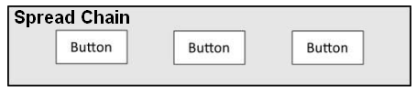

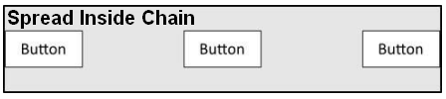
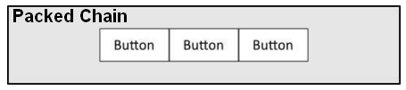
A Guide to the Android ConstraintLayout
Chains
ConstraintLayout chains provide a way for the layout behavior of two or more widgets to be defined as a group
Chain Styles

Slide 12
A Guide to the Android ConstraintLayout
Working with Guidelines
Guidelines are special elements available within the ConstraintLayout that provide an additional target to which constraints may be connected
ConstraintLayout Advantages
Flexibility
Avoiding inherent problems
less complex design
performance at runtime

Slide 13
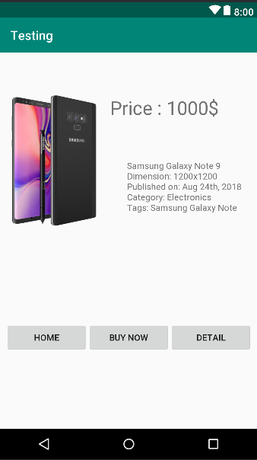
An Android Studio Layout Editor ConstraintLayout Tutorial
Let’s design !

Slide 14

End of Lesson 3

Slide 15
Thank you!

